Slide 1
Introduction to Machine Learning

Slide 2
What is ML?
subfield of Artificial Intelligence (AI)
name is derived from the concept that it deals with
“construction and study of systems that can learn from data”
can be seen as building blocks to make computers learn to behave more intelligently

Slide 3
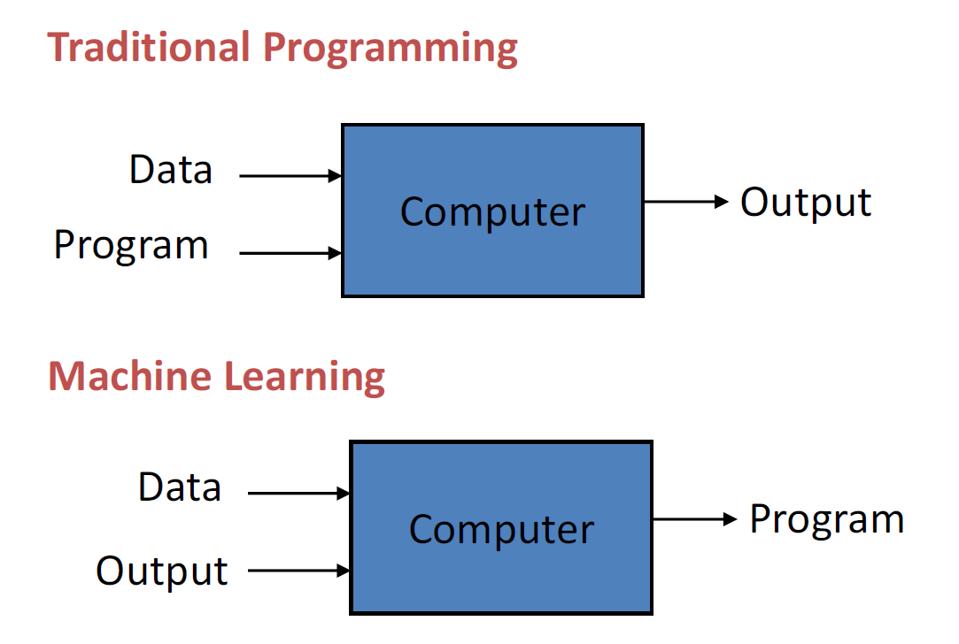

Slide 4
Definition of ML
“A computer program is said to learn from experience (E) with some class of tasks (T) and a performance measure (P) if its performance at tasks in T as measured by P improves with E”

Slide 5
Categories
Supervised Learning
Unsupervised Learning
Semi-Supervised Learning
Reinforcement Learning

Slide 6
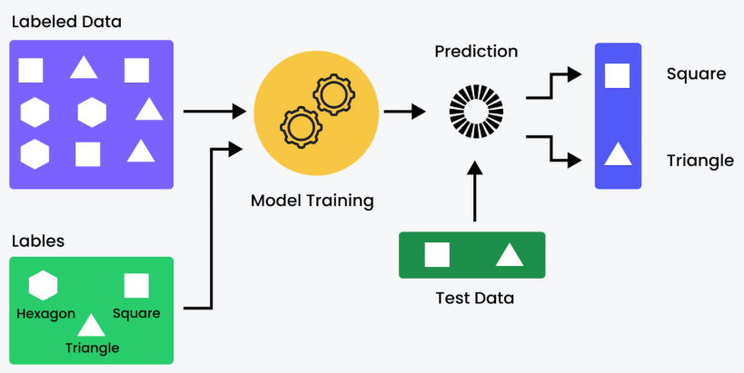
Supervised Learning
Training data is labelled containing both descriptions(input) and the target(output).
training data (input, target)
input – description of a face, area of a house
target – happy, price of the house

Slide 7
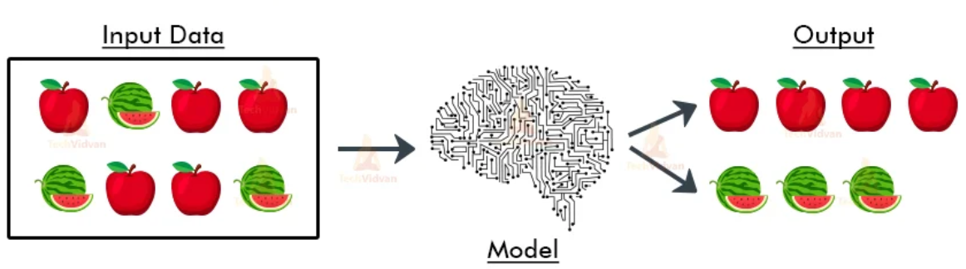
Unsupervised Learning
Training data is not labelled, contains only descriptions(input).
training data (input)
input – round shaped, red coloured, green coloured
Model forms clusters of similar items.

Slide 8
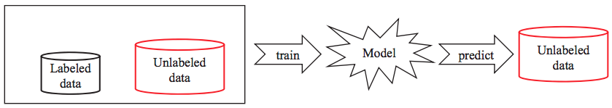
Semi-Supervised Learning
combines a small amount of labeled data with a large amount of unlabeled data during training.

Slide 9
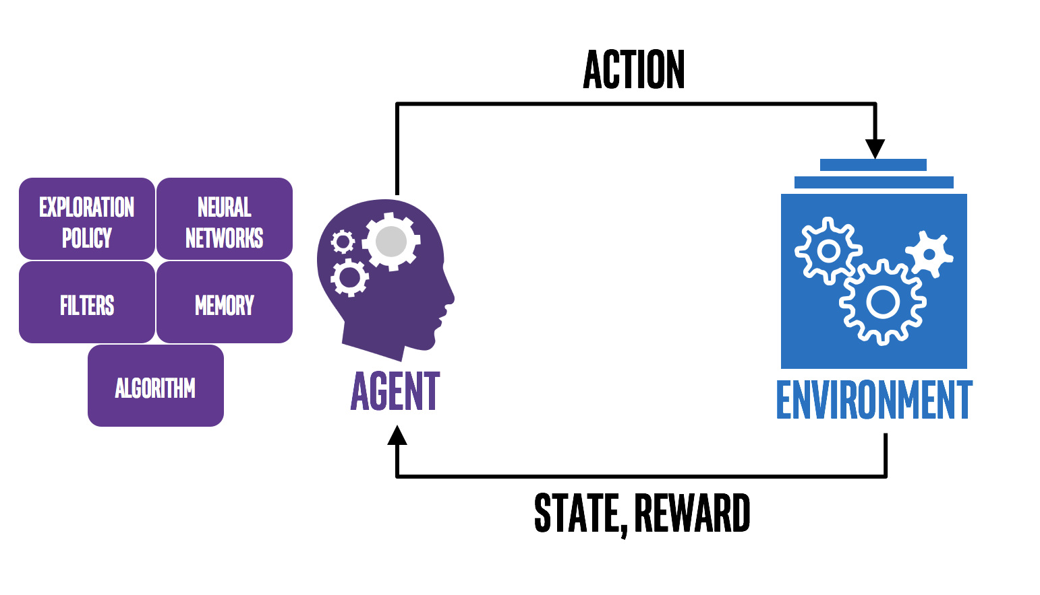
Reinforcement Learning
It is the training of machine learning models to make a sequence of decisions.
The computer employs trial and error to come up with a solution to the problem.
The agent gets either rewards or penalties for the actions it performs.

Slide 10
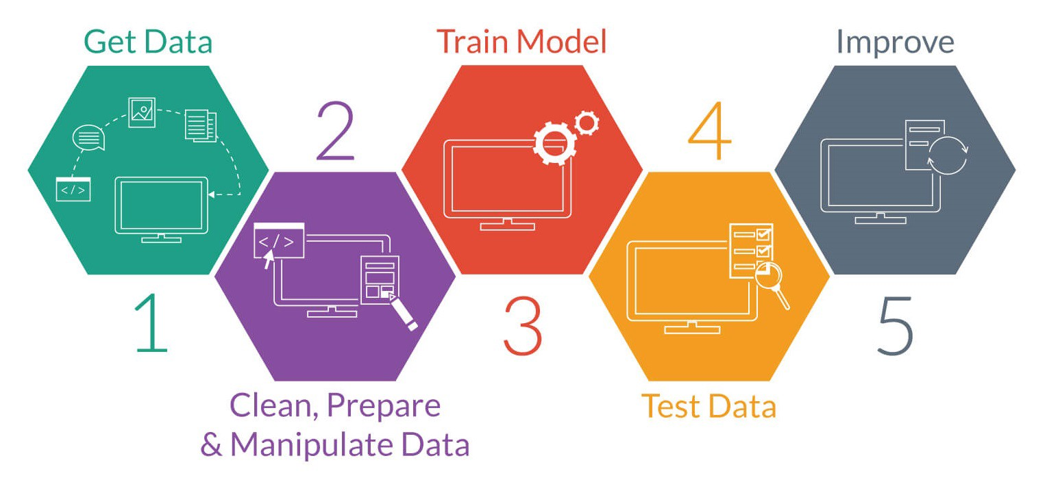
Workflow

Slide 11
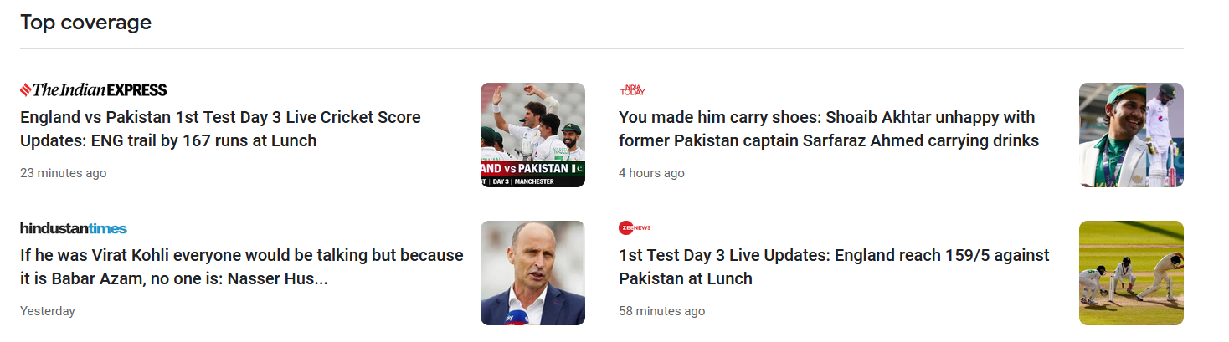
Machine Learning Techniques
Supervised learning
Regression – target is continuous (E.g. house price prediction)
Classification – target is discrete (E.g. spam email classification)
Unsupervised learning
Clustering: forming groups of similar items.

Slide 12
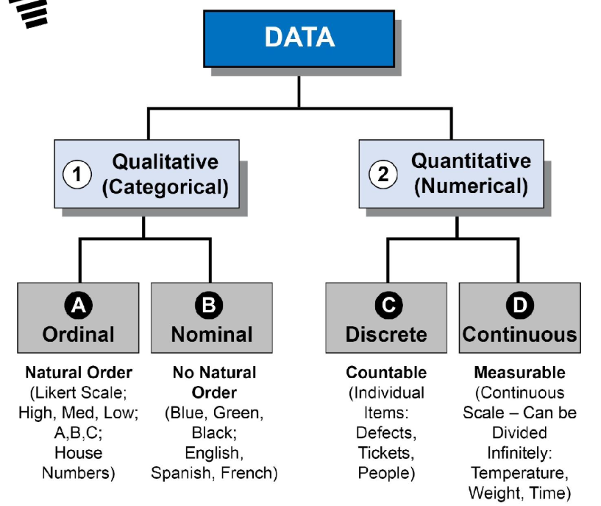
Types of data

Slide 13
Continuous data
Interval
Equal intervals between values
No true zero (zero does not mean none)
Addition and subtraction are meaningful
E.g. Date, temperature, time
Ratio
Like interval data but has true zero
Addition, subtraction, multiplication and division are meaningful.
E.g. Speed, distance

Slide 14
*** END ***

